Slide 1
Recognizing Speech emotion
PRINCIPLES OF DATA SCIENCE
Ram Venkat Buddala
Surya Vamsi Pasupuleti
Dheeraj Reddy Mangalaram
Harika

Slide 2
introduction
Speech Emotion Detection (SED) is a subfield of Natural Language Processing (NLP) that involves identifying the emotional state of a speaker through analysis of their speech.
SED has a wide range of applications, including in call centers, mental health treatment, and customer service
The process of SED involves using machine learning algorithms to analyze the acoustic and linguistic features of speech, such as pitch, tone, and word choice.
The goal of SED is to accurately classify emotions such as happiness, anger, and sadness, which can be challenging due to the complexity and variability of human emotion.

Slide 3
METHDOLOGY
The speech emotion detection system is constructed using an ML model.
The initial step is to collect pertinent information.
The second step, called feature engineering, resolves data quality and representation issues.
The third phase, known as the "meat and potatoes" phase, involves developing an algorithm-based model that analyzes data, adjusts to new information, and learns from past mistakes.

Slide 4
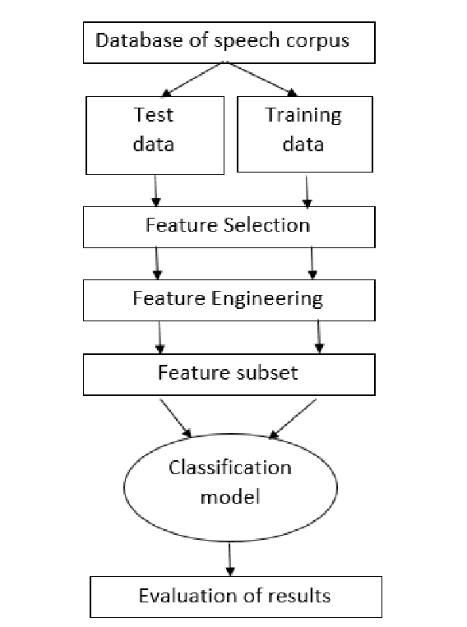
FLOWCHART

Slide 5
DATASET
TESS(TORONTO EMOTIONAL SPEECH SET)
There are 2800 audio tracks in the database, and they represent seven different fundamental emotions: happy, sad, angry, surprised, afraid, disgusted, and neutral
Characteristics of the dataset suitable for the task include sufficient size, variety of emotions, and audio files in mono signals that can be easily converted using existing software libraries.

Slide 6
DATA QUALITY ISSUES
Data must be cleaned to perform any meaningful analysis. As a next step, the dataset thus collected had to be inspected for its quality. Some of the data quality issues addressed for this experimentation include:
1. Missing value analysis
2. Outlier identification
3. Null value handling
4. Invalid data
5. Duplicate data

Slide 7
RESULTS
After reading in an emotional audio dataset, the algorithm proceeds to extract Mel-frequency cepstral coefficients (MFCCs) from the audio files by using the librosa package.
MFCCs are short-term power spectrum features frequently used in audio signal processing for speech recognition, speaker identification, and music genre classification.
These qualities are used to create a one-hot encoded representation of the emotions in the dataset.

Slide 8
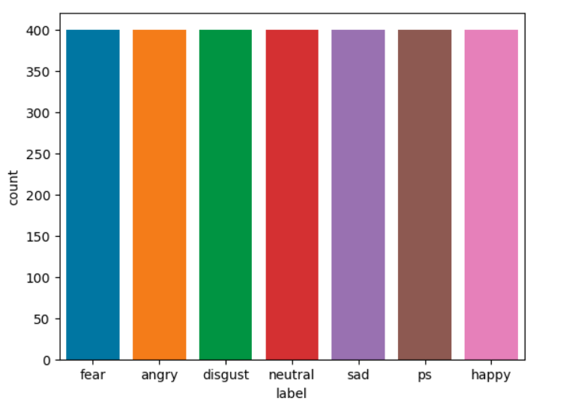

Slide 9
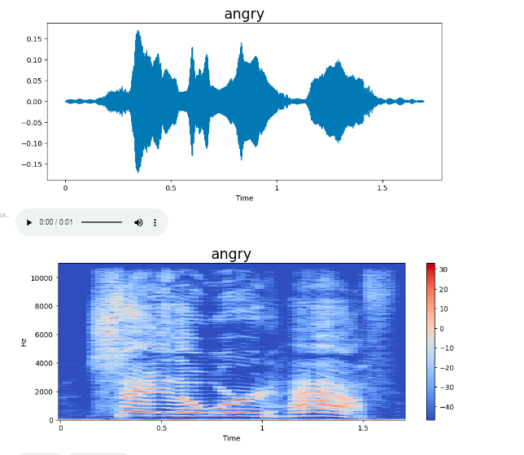
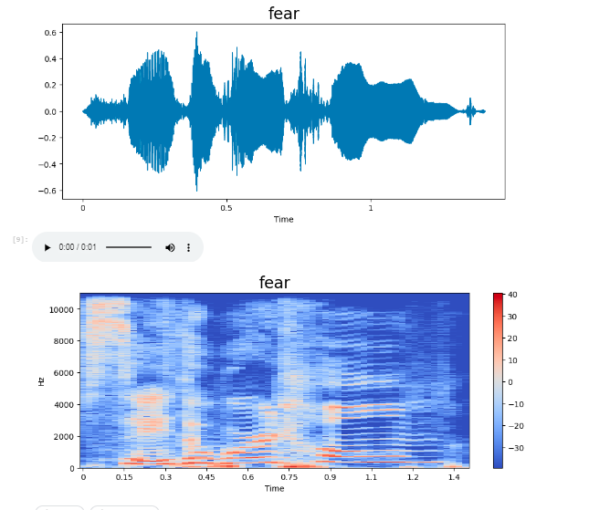
FEAR & ANGRY

Slide 10
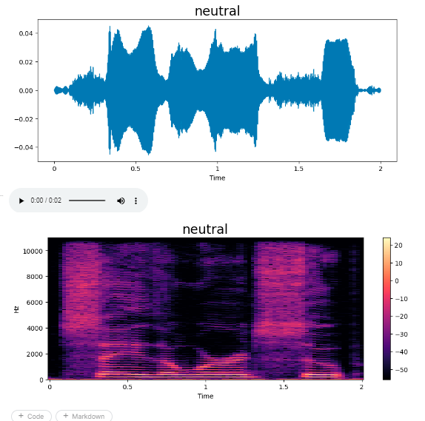
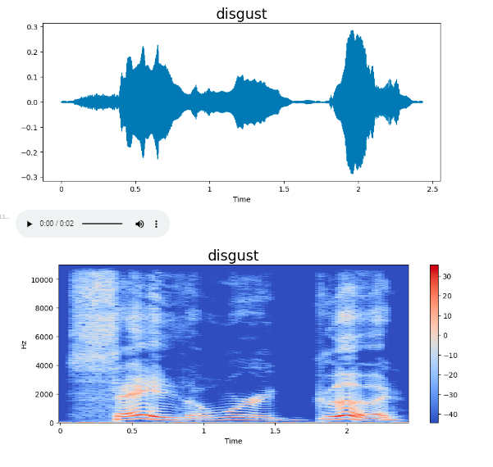
DISGUST & NEUTRAL

Slide 11
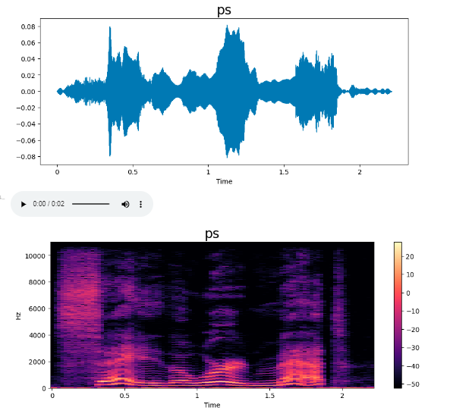
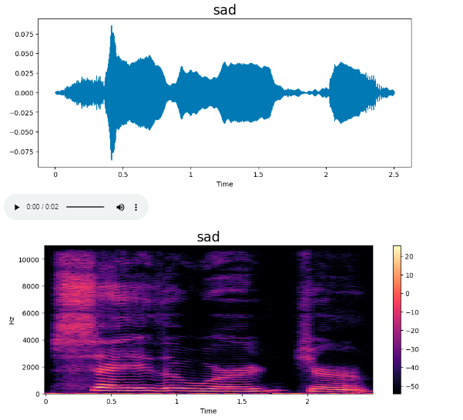
SAD & PS

Slide 12
Feature Extraction
Feature extraction is the process of extracting meaningful information, or features, from audio signals that can be used to train machine learning models
So it can make predictions or new decisions when it sees unseen data based on the patterns it has learned from a set of labeled training data.
There are several types of feature extractions that can be used for audio processing. Some common ones include Mel-frequency cepstral coefficients (MFCCs), Spectrograms, Zero crossing rate, Time domain feature

Slide 13
MFCC
We used Mel-frequency cepstral coefficients (MFCCs)
MFCC is a feature extraction Technique. The main aim of Mfcc is to extract a set of features from an audio signal that captures the spectral characteristics of the signal over time
It is a commonly used feature extraction technique in audio signal processing
MFCCs are derived from the power spectrum of an audio signal and represent a compressed form of the spectral information
The resulting MFCCs are typically represented as a matrix of coefficients, with each row representing the MFCCs for a single frame of the signal. MFCCs are often used as input features for machine-learning algorithms

Slide 14
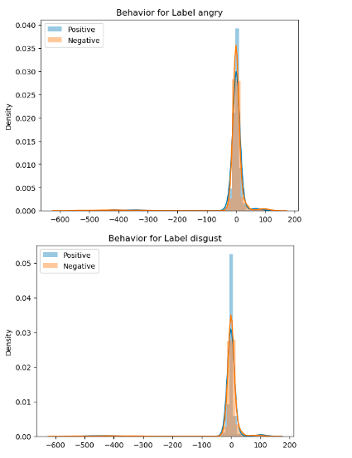
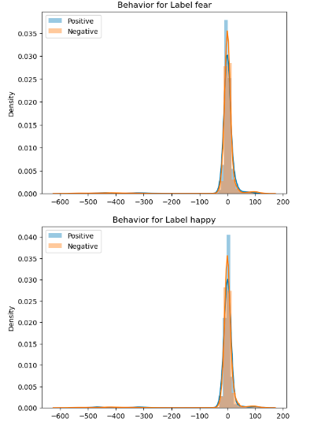
Behavior Of Emotions

Slide 15
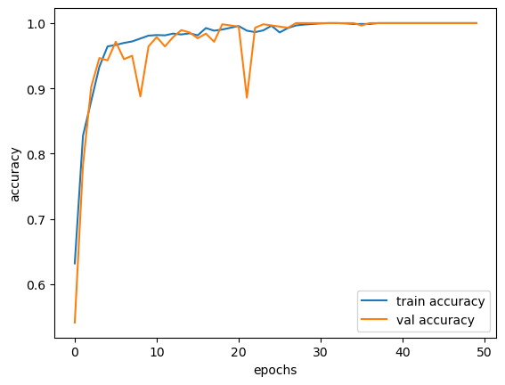
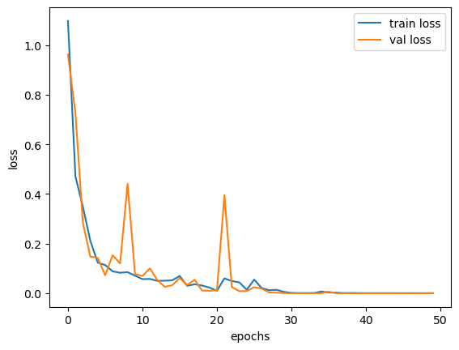
ACCURACY & LOSS
Accuracy and loss of a model over the training epochs using the matplotlib library in Python.
The x-axis represents the number of epochs, while the y-axis represents the accuracy and loss.

Slide 16
CONCLUSION
AI and machine learning have brought about a new era of automation, especially in voice-activated systems
Vocal emotion detection can enhance these systems and has various applications, such as automatic translation and computer-based education
The thesis outlines the steps in constructing a speech emotion recognition system, including feature extraction and choosing a classifier
Using multiple features leads to better recognition rates than using just one
Speech-based emotion identification systems have several potential uses in the future.

